Slide 1

Your Blockchain Adventure
Or: How You shall learn to Stop Worrying and Love the Blockchain

Slide 2
Who is NOT interested in Blockchain?

Slide 3
Who does NOT like to go on vacation?

Slide 4

This Photo by Unknown Author is licensed under CC BY-SA

Slide 5

Disclaimer: Vacation is just an example
Decentralised finance
Fair trading
Auditing
place your idea here
This Photo by Unknown Author is licensed under CC BY-SA

Slide 6
What does Blockchain and Vacation have in common?

Slide 7

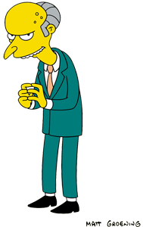
What does Blockchain and Vacation have in common?
Notes:
Your grandpa never heard of them
Your manager should approve the use but not intrude in it

Slide 8

Coming soon…
Why should you use a Blockchain?
How can you use Blockchain with the Microsoft Power Platform

Slide 9
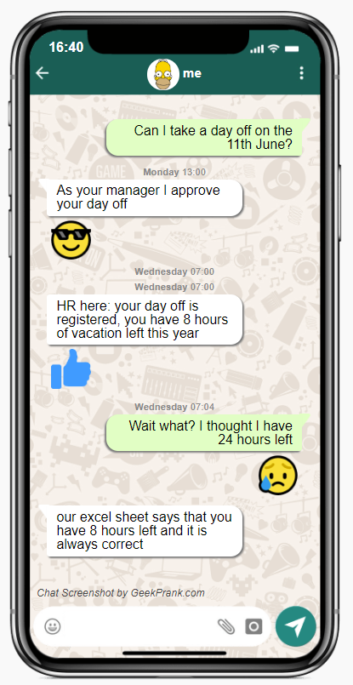
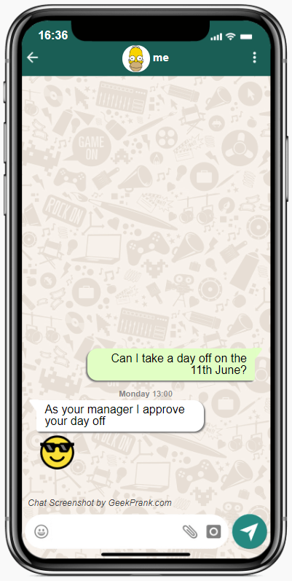
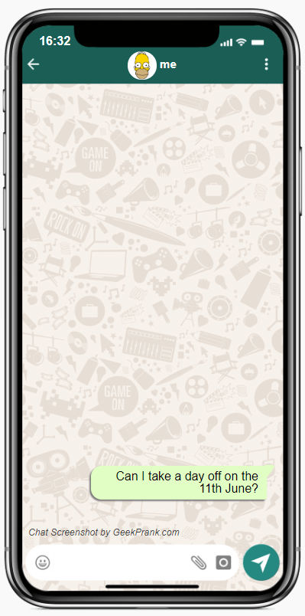
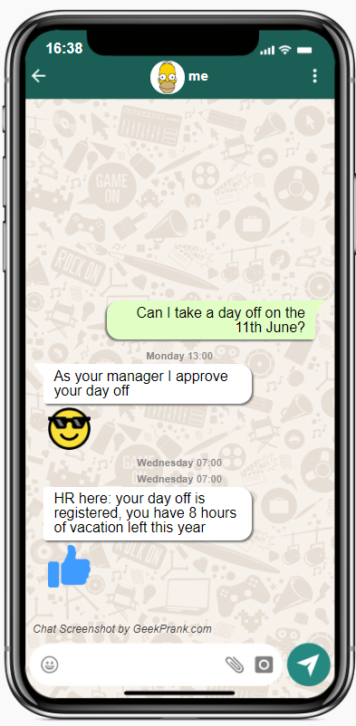
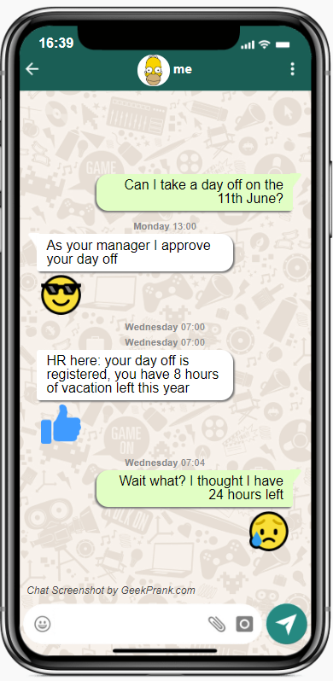
Traditional process

Slide 10
Traditional process – when does it break?
Can I trust it?
Central authority
It is secure?
What if I don't agree?
No single point of truth
Central store

Slide 11
Who owns your holiday hours?

Slide 12
How much are your holiday hours worth?

Slide 13
Do you trust a stranger with 1000s of euros worth of your property and no accountability?

Slide 14
You need a Contract

Slide 15

Modern process – VAC token

Slide 16
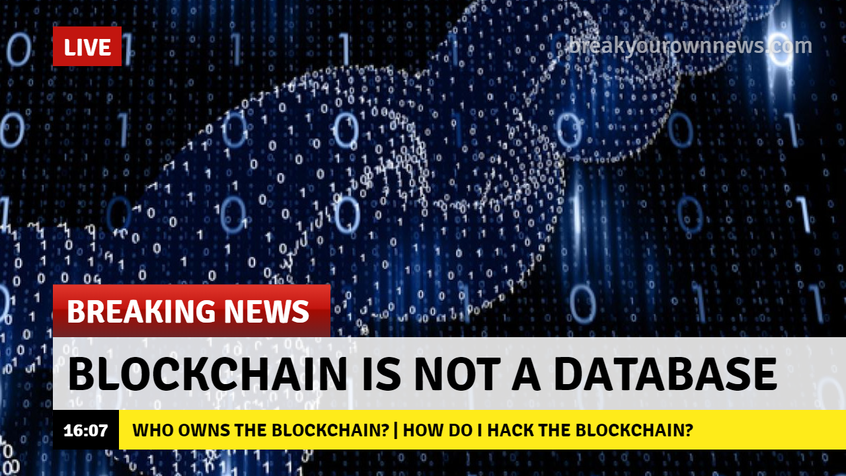
Notes:
Blockchain is distributed – everyone owns the blockchain
Everyone has the right to reject a transaction
To hack the blockchain, an encrypted transaction must be placed and accepted by all nodes at the same time

Slide 17
What’s new?
Holidays are truly yours
Single point of truth verifiable with multiple sources

Slide 18
PowerApp

Slide 19
Blockchain explorer

Slide 20
Infrastructure

Slide 21
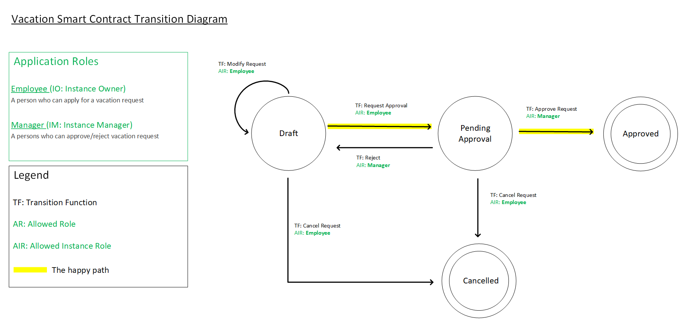
Solidity contract

Slide 22
How the Powerapp was built (connector, ABI, network)

Slide 23
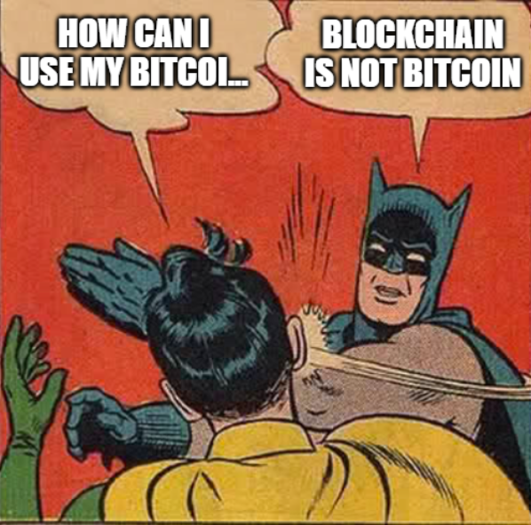
Questions

Slide 24
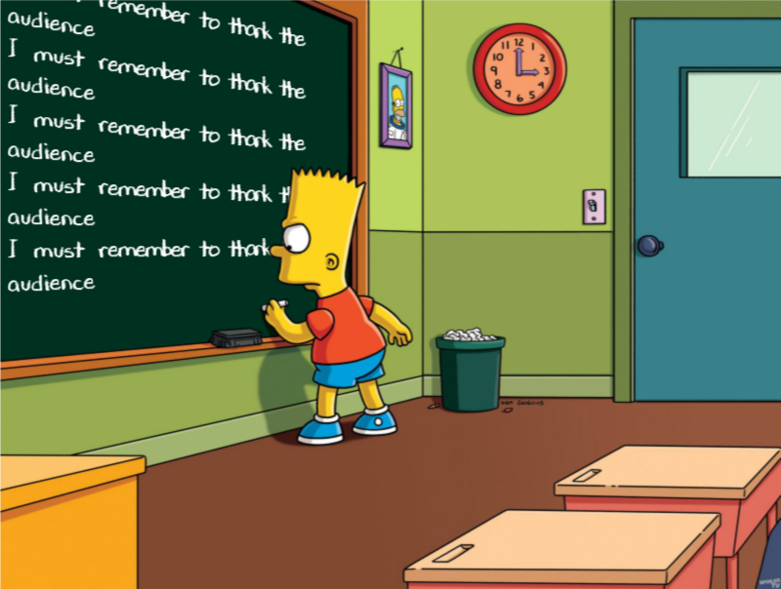

Slide 25
Links/References

